Slide 1
Hindu Art
History of Art
BFA- I
Section C, D
Teacher: Aasma Abdul Majeed
Visual Arts: LCWU

Slide 2
Introduction: Hinduism and Hindu Art Hinduism is the predominant religion of the Indian subcontinent. Dating back to the Iron Age , it is often called the oldest living religion in the world. Hinduism has no single founder and is a conglomeration of diverse traditions and philosophies rather than a rigid set of beliefs. Most Hindus believe in a single supreme God who appears in many different manifestations as devas (celestial beings or deities), and they may worship specific devas as individual facets of the same God. Hindu art reflects this plurality of beliefs, and Hindu temples, in which architecture and sculpture are inextricably connected, are usually devoted to different deities. Deities commonly worshiped include Shiva the Destroyer; Vishnu in his incarnations as Rama and Krishna; Ganesha, the elephant god of prosperity; and different forms of the goddess Shakti (literally meaning “power”), the primordial feminine creative principle. These deities are often portrayed with multiple limbs and heads, demonstrating the extent of the god’s power and ability. Hindu art is also characterized by a number of recurring holy symbols, including the om , an invocation of the divine consciousness of God; the swastika, a symbol of auspiciousness; and the lotus flower, a symbol of purity, beauty, fertility, and transcendence.

Slide 3
Key Points Hindu art represents a plurality of beliefs and has deeply influenced the painting, sculpture, and architecture of the Indian subcontinent. Architecture and sculpture are inextricably linked in Hindu temples, which are usually devoted to a number of different deities . A Hindu temple generally consists of an inner sanctum, in which the idol of the deity is housed; a congregation hall; and sometimes an antechamber and porch. Two main styles of temples exist in India: the north Indian Nagara style, characterized by a beehive shaped central tower, and the south Indian Dravidia style, characterized by a graduated tower with multiple layered pavilions. The period between the 6th and 12th centuries was marked by the appearance of a large number of Hindu states and was a productive and creative period for Hindu temple architecture.

Slide 4
Hindu Temples A Hindu temple generally consists of a garba griha (“womb chamber”), the inner sanctum in which the murti , or idol of the deity, is housed; a congregation hall; and sometimes an antechamber and porch. The garba griha is surmounted by a shikhara , or tower. Two main styles of temples exist in India: the northern Nagara style and the southern Dravida style. The Nagara Style In the northern Nagara style, the shikhara takes the shape of a curvilinear beehive. The temple is a square with a number of graduated projections in the middle of each side, giving a cruciform shape with a number of re-entrant angles on each side. The projections in the plan are also carried upwards to the top of the shikhara, giving a strong emphasis on vertical lines in elevation .

Slide 5
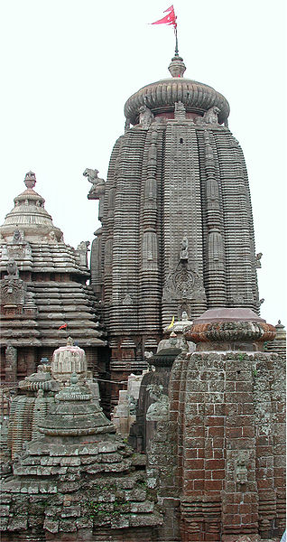
Lingaraj Temple, Bhubaneshwar, Orissa: The 11th century Lingaraj Temple is a fine example of the north Indian Nagara style of temple architecture, marked by its curvilinear, beehive-shaped shikhara.

Slide 6
The Dravidian Style In the southern Dravidian style, the tower or gopuram consists of progressive smaller stories of pavilions. These temples were square in plan and pyramidal in shape; included porches (mandapams) and pillard halls (chaultris or chawadis); and contained tanks or wells for water to be used for sacred purposes or the convenience of the priests.

Slide 7
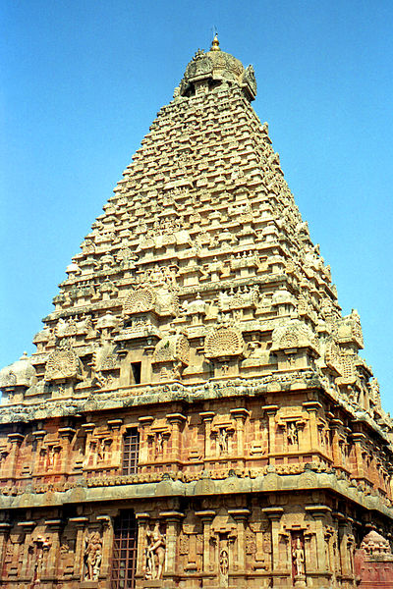
Brihadeeswarar Temple Gopuram Detail: The Brihadeeswarar Temple in Tanjore has the tallest Dravida style tower (216 feet) in India. The multiple stories are ornately carved.

Slide 8
History and Well-Known Temples The earliest Hindu temples found in India date back to the Gupta period (ca. 320–550 CE); one of these is the Dashavatara Vishnu Temple in Deogarh in central India, built ca. 500 CE. The period between the 6th and 12th centuries was marked by the appearance of a large number of states, most of which were ruled by Hindu dynasties . This was a deeply productive and creative period for Hindu temple architecture, and many beautiful examples survive to the present day. Some surviving works include the monumental , rock-cut Kailashnath Temple (754–774 CE) dedicated to Shiva at Ellora in the western state of Maharashtra; the 11th century Brihadeeswarar Temple in Tanjore in the southern state of Tamil Nadu, which is India’s largest temple; and the Sun Temple (1238–1250 CE) at Konarak in Orissa. Although many Hindu temples were destroyed during the period of Muslim rule in India (12th to 18th centuries), Hindu influence on Indian art and architecture has withstood the test of time and continues to shape works of art.

Slide 9
Hindu Sculpture Hindu sculpture represents the themes of its religion through its depiction of deities and recurring symbols, such as the lotus flower.

Slide 10
Key Points Most Hindus believe in a single supreme God who appears in many different manifestations as devas, or celestial beings or deities ; Hindu sculpture reflects this plurality of beliefs. Because religion and culture are inseparable with Hinduism , recurring symbols such as the gods and their reincarnations, the lotus flower, and extra limbs make their appearances in many sculptures of Hindu origin. Deities are often portrayed with multiple limbs and heads, demonstrating the extent of the God’s power and ability. Hindu sculpture is characterized by recurring holy symbols such as the om , an invocation of the divine consciousness of God; the swastika, a symbol of auspiciousness; and the lotus flower, a symbol of purity, beauty, fertility, and transcendence. Sculpture is inextricably linked with architecture in Hindu temples, which are usually devoted to a number of different deities.

Slide 11
Hinduism: A religion or a way of life found most notably in India and Nepal; with over one billion followers, it is the world’s third largest religion by population. dharma: A key concept with multiple meanings in the Indian religions Hinduism, Buddhism, Sikhism, and Jainism; in Hinduism, it signifies behaviors that are considered to be in accord with the order that makes life and universe possible, including duties, rights, laws, conduct, virtues, and “right way of living.”

Slide 12
Depictions of Deities Deities commonly worshiped and portrayed through sculpture include Shiva the Destroyer; Vishnu in his incarnations as Rama and Krishna; Ganesha, the elephant god of prosperity; and different forms of the goddess Shakti (literally meaning “power”), the primordial feminine creative principle. These deities are often portrayed with multiple limbs and heads, demonstrating the extent of the god’s power and ability. For example, the goddess Sarasvati is always depicted with a minimum of four arms: two of the arms will be playing a vina, representing the tuning of her knowledge; her other two hands often hold prayer beads and a scripture, both of which represent her devotion to her spirituality. As the goddess of learning and art, she is depicted in this way as very capable and powerful in her area of expertise.

Slide 13
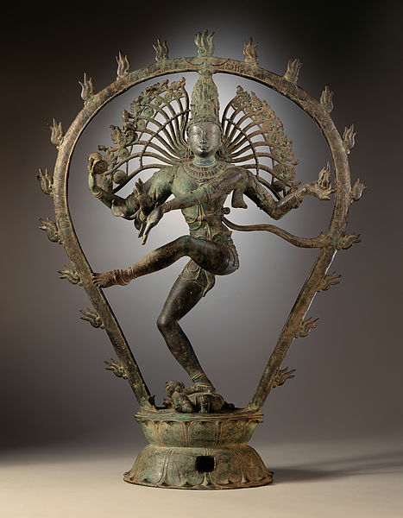
Shiva Nataraja, the Lord of the Dance: Nataraja from Tamil Nadu, India. Chola dynasty copper alloy sculpture, ca. 950–1000 CE. The deity is depicted as having multiple arms, as is common for idols of Hindu gods.

Slide 14
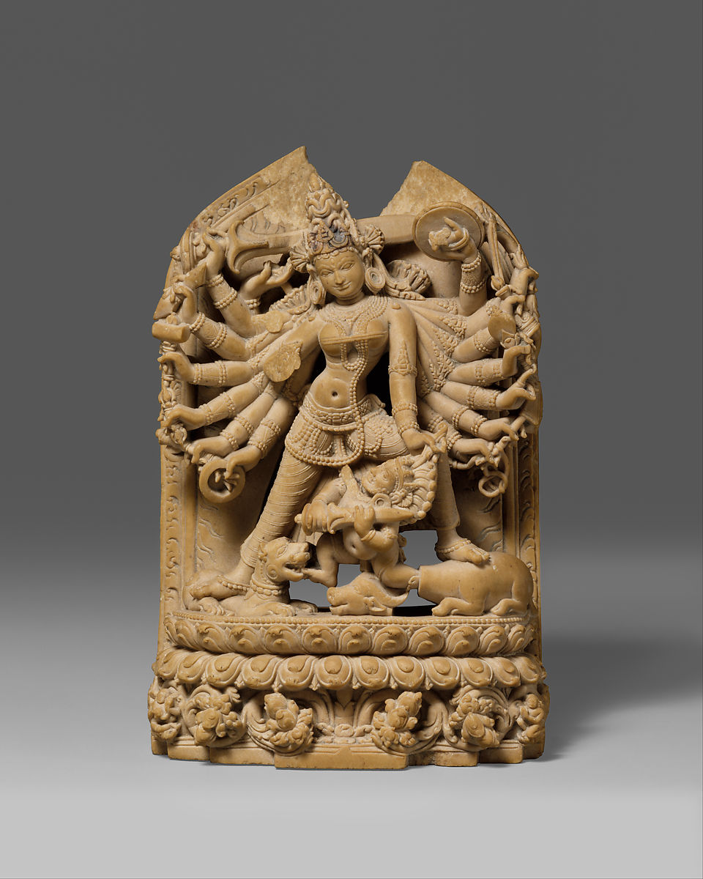

Slide 15
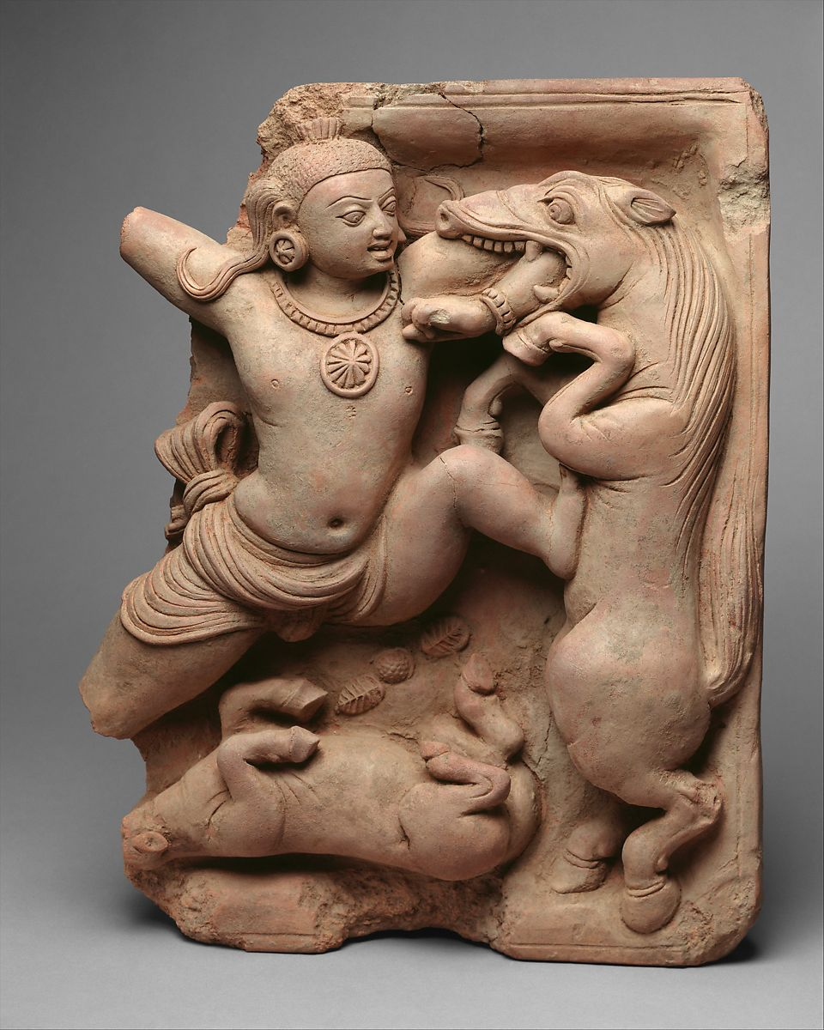

Slide 16
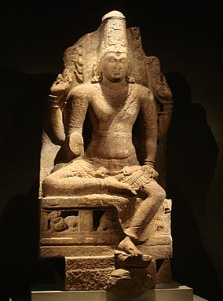
Four-armed Vishnu seated in lalitasana, Pandya Dynasty, 8-9th century CE

Slide 17
Early reliefs (1st century BCE)

Slide 18
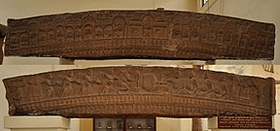
The Katra architrave, possibly representing Brahmins and the cult of the Shiva Linga, Mathura, circa 100 BCE^{[8]}

Slide 19
Worship of Shiva Linga by Gandharvas, 2nd-1st century BCE

Slide 20
Hindu art under the Kushans (2nd-3rd century CE)

Slide 21
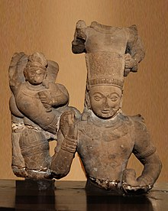
The Caturvyūha Viṣṇu: Vāsudeva and other members of the Vrishni clan.^{[11]} Vāsudeva (avatar of Vishnu) is fittingly in the center with his heavy decorated mace on the side and holding a conch, his elder brother Balarama to his right under a serpent hood, his son Pradyumna to his left (lost), and his grandson Aniruddha on top.^{[11][12]} 2nd century CE, Mathura Museum.

Slide 22
Sun God Surya, also revered in Buddhism, Kushan Period

Slide 23
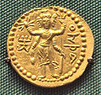
Three-faced Oesho, often identified with Shiva, on a coin of Huvishka.^{[19]}

Slide 24
Hindu art under the Guptas (4th-6th century CE)

Slide 25
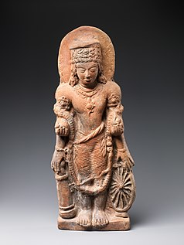
A terracotta statue of Vishnu Caturanana ("Four-Armed"), using the attributes of Vāsudeva-Krishna, with the addition of an aureole around the head (5th century CE). Uttar Pradesh.^{[20]}

Slide 26
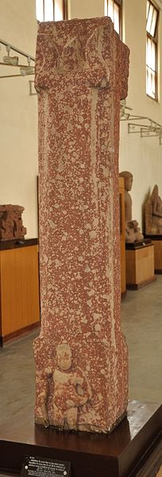
Pillar recording the installation of Shiva Lingas in the "year 61" (380 CE) during the rule of Chandragupta II.^{[25][21]}

Slide 27
Vishnu Caturanana ("Four-Armed"), 5th century, Mathura

Slide 28
Medieval period (8th-16th century) Hindu art became largely prevalent from the Medieval period onward. It was accompanied by the decline of Buddhism in the Indian subcontinent.

Slide 29
Sarvatobhadra Shiva Linga Representing Brahma Vishnu Maheshwar and Surya, Circa 9th Century CE

Slide 30
Durga, Medieval Period

Slide 31
Four-armed Seated Vishnu in Meditation, Mediaeval Period

Slide 32
Ten-armed Ganesha, Medieval Period

Slide 33
Connection to Architecture Sculpture is inextricably linked with architecture in Hindu temples, which are usually devoted to a number of different deities. The Hindu temple style reflects a synthesis of arts, the ideals of dharma , beliefs, values , and the way of life cherished under Hinduism. Elaborately ornamented with sculpture throughout, these temples are a network of art, pillars with carvings, and statues that displayed.

Slide 34
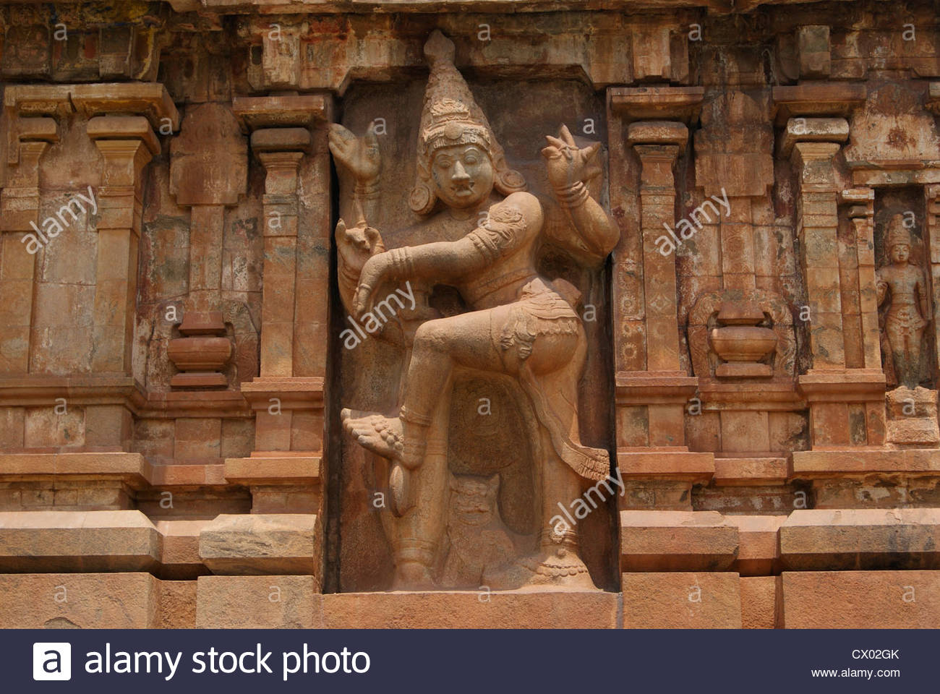
Ancient Hindu Architectural Sculpture works carved in Big stones ...

Slide 35
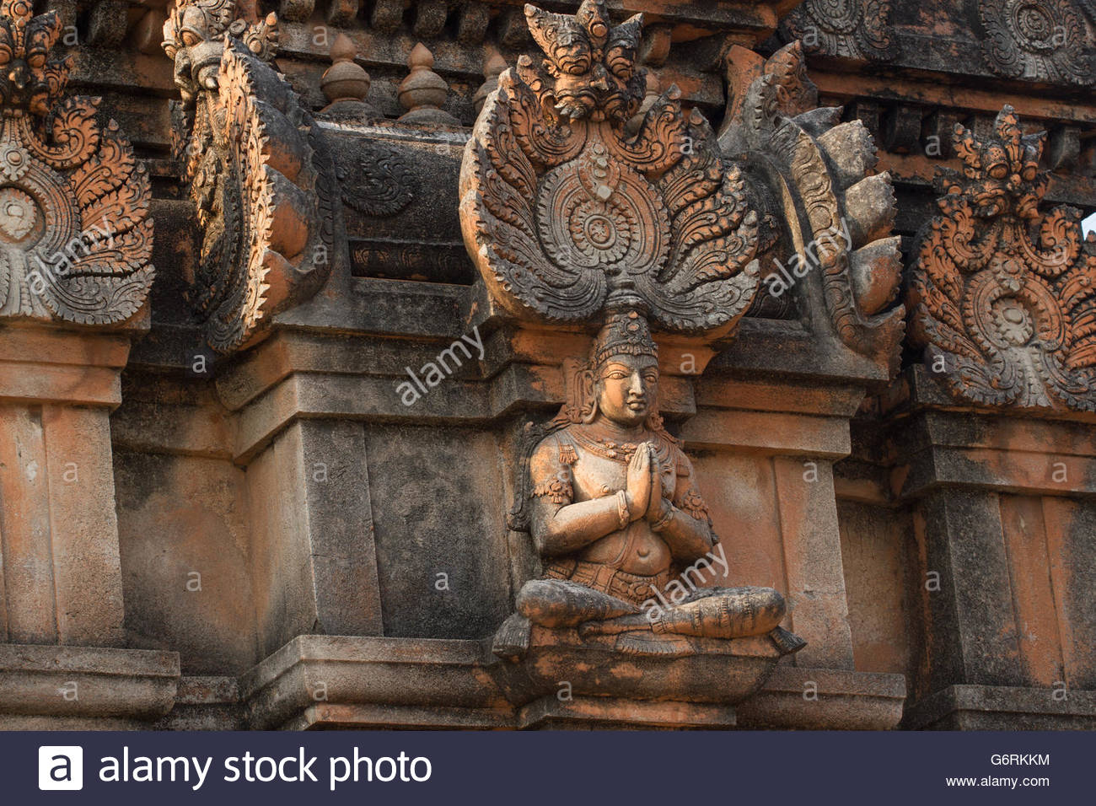
Sculpture on Hinduism religious temple

Slide 36
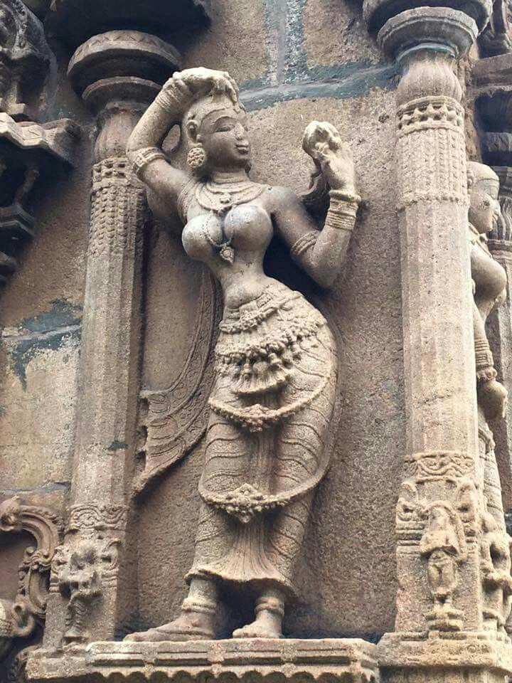
Hindu statues

Slide 37
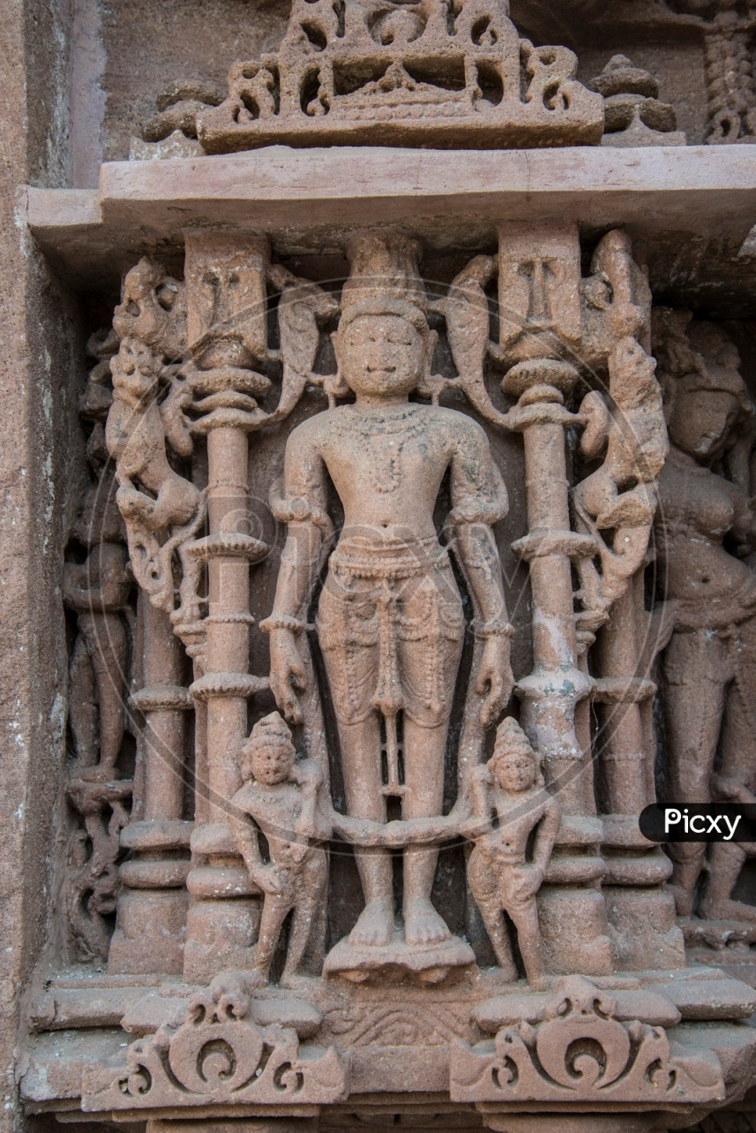
Image of Ancient Hindu Statues At Jain Temple,

Slide 38
Wall Paintings

Slide 39
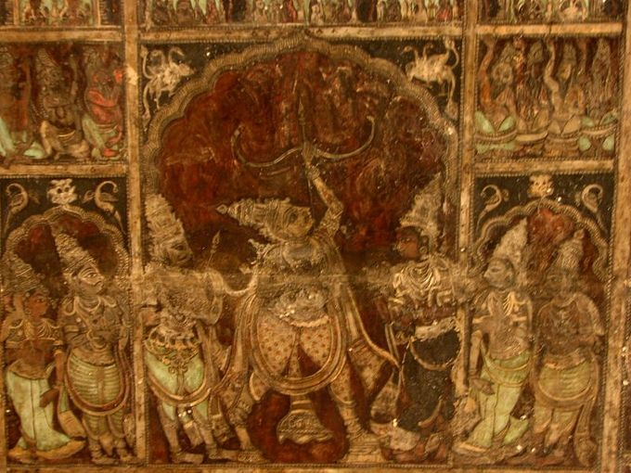
Vijayanagar art includes wall paintings such as the Dashavatara (the Ten Avatars of Vishnu) and the Girijakalyana (the marriage of Parvati, Shiva’s consort) in the Virupaksha Temple at Hampi; the Shivapurana murals (the Tales of Shiva) at the Virabhadra temple at Lepakshi; and those at the Kamaakshi and Varadaraja temples at Kanchi.

Slide 40
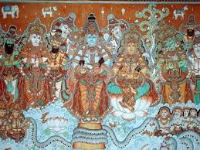

Slide 41
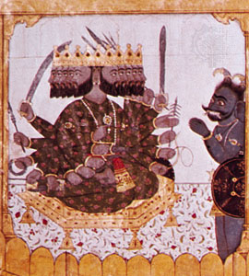
Hinduism - The prehistoric period (3rd and 2nd millennia bce ...

